Slide 1




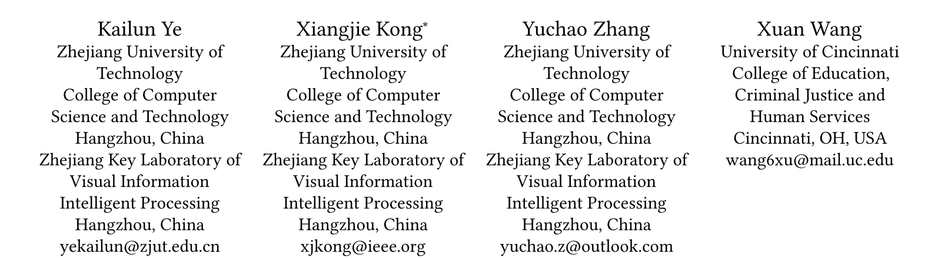





ATAI
Advanced Technique of Artificial Intelligence
ATAI
ChongqingUniversity _{AdvancedTechniqueof}
of Technology Artificial Intelligence
Chongqing University of
Technology
Chongqing University ^{ATAI}
_{of Technology} Advanced Techniqueof
Artificial Intelligence
Chongqing University of Technology
Chongqing University of Technology
Dual History Enhancement with Hybrid Hypergraph-Graph
Networks for Temporal Knowledge Graph Reasoning
code:None
——WWW 2026
Reported by Xiang Zhang
1

Slide 2
ATAI
Advanced Technique of Artificial Intelligence
ATAI
ChongqingUniversity _{AdvancedTechniqueof}
of Technology Artificial Intelligence
Chongqing University of
Technology
Chongqing University ^{ATAI}
_{of Technology} Advanced Techniqueof
Artificial Intelligence
Chongqing University of Technology
Chongqing University of Technology
Motivation
(1) Traditional GNNs,constrained by their low-order neighborhood aggregation design, inherently fail to model potential high-order dependencies among facts.
(2) For global history modeling,they exhibit notable limitations: being prone to frequency-dominated prediction bias or assuming uniform contributions fromall historical events while neglecting their significance to current predictions

Slide 3
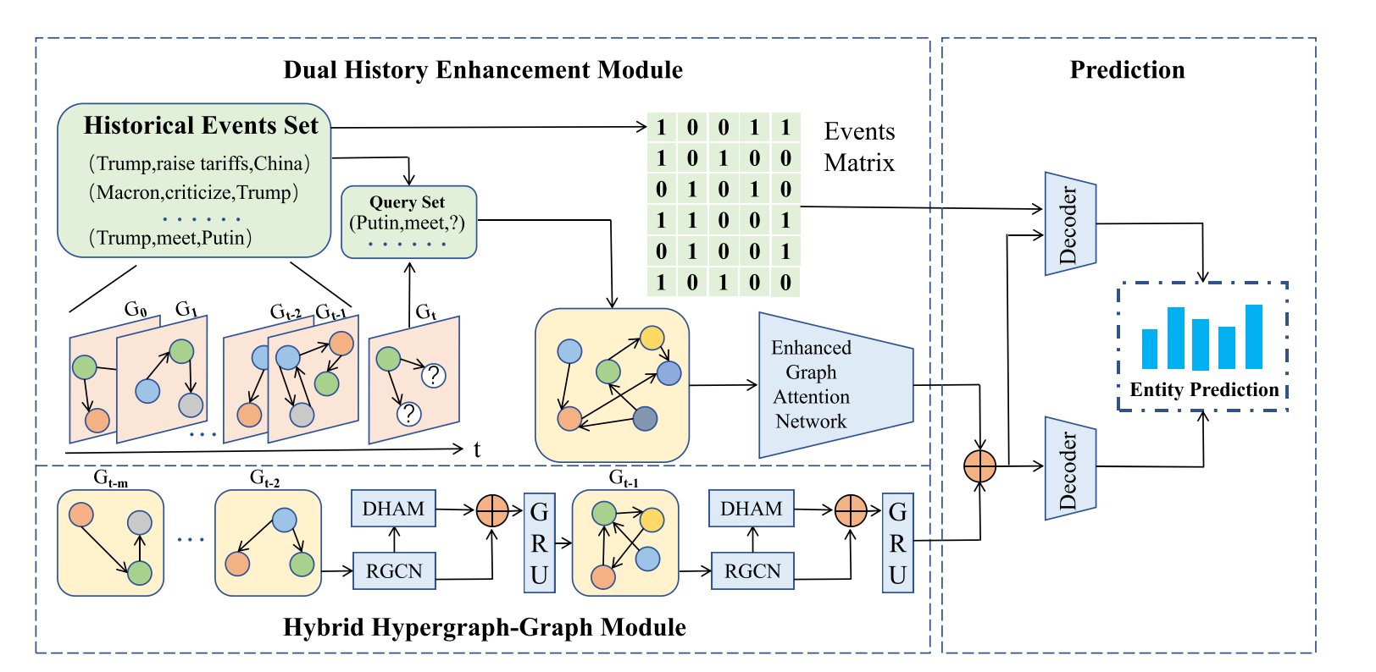
ATAI
Advanced Technique of Artificial Intelligence
ATAI
ChongqingUniversity _{AdvancedTechniqueof}
of Technology Artificial Intelligence
Chongqing University of
Technology
Chongqing University ^{ATAI}
_{of Technology} Advanced Techniqueof
Artificial Intelligence
Chongqing University of Technology
Chongqing University of Technology
Overview

Slide 4
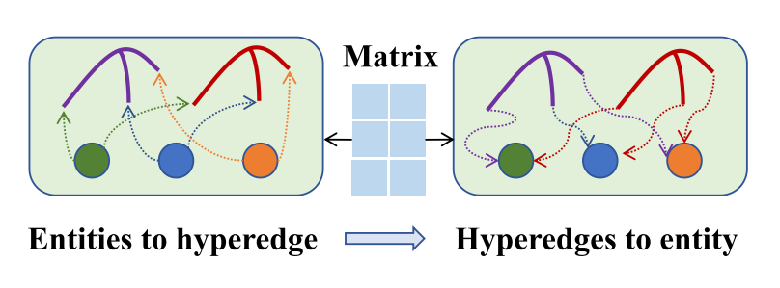
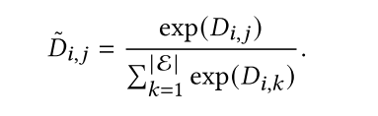
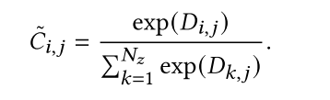
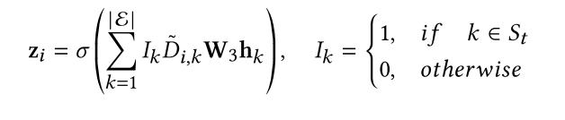
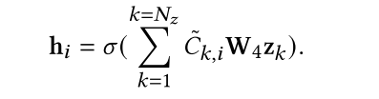
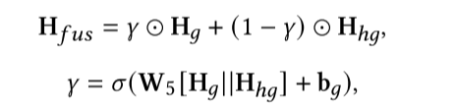

ATAI
Advanced Technique of Artificial Intelligence
ATAI
ChongqingUniversity _{AdvancedTechniqueof}
of Technology Artificial Intelligence
Chongqing University of
Technology
Chongqing University ^{ATAI}
_{of Technology} Advanced Techniqueof
Artificial Intelligence
Chongqing University of Technology
Chongqing University of Technology
Method

Slide 5
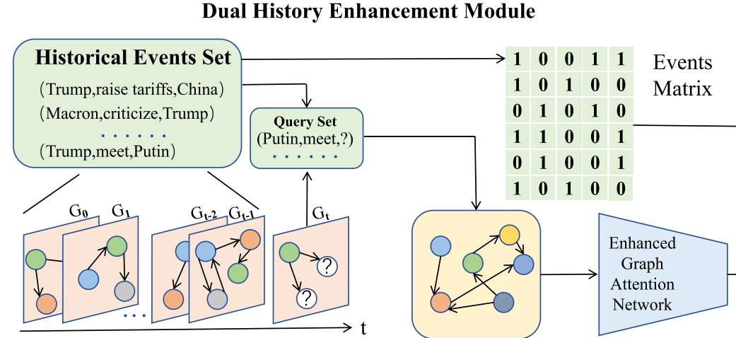

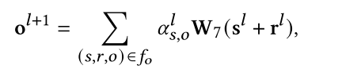
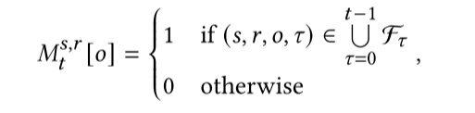
ATAI
Advanced Technique of Artificial Intelligence
ATAI
ChongqingUniversity _{AdvancedTechniqueof}
of Technology Artificial Intelligence
Chongqing University of
Technology
Chongqing University ^{ATAI}
_{of Technology} Advanced Techniqueof
Artificial Intelligence
Chongqing University of Technology
Chongqing University of Technology
Method

Slide 6
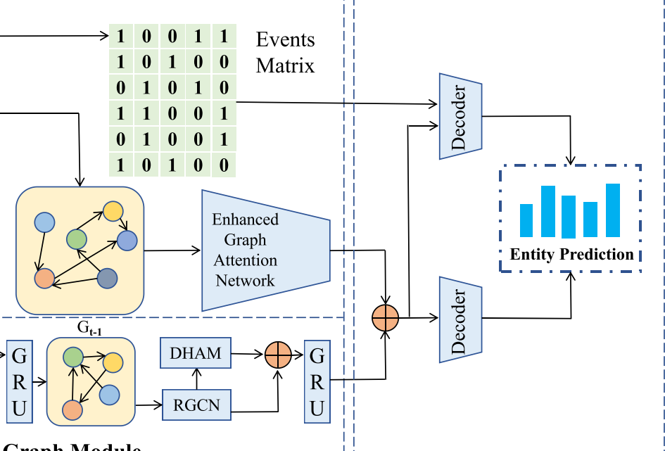



ATAI
Advanced Technique of Artificial Intelligence
ATAI
ChongqingUniversity _{AdvancedTechniqueof}
of Technology Artificial Intelligence
Chongqing University of
Technology
Chongqing University ^{ATAI}
_{of Technology} Advanced Techniqueof
Artificial Intelligence
Chongqing University of Technology
Chongqing University of Technology
Method

Slide 7
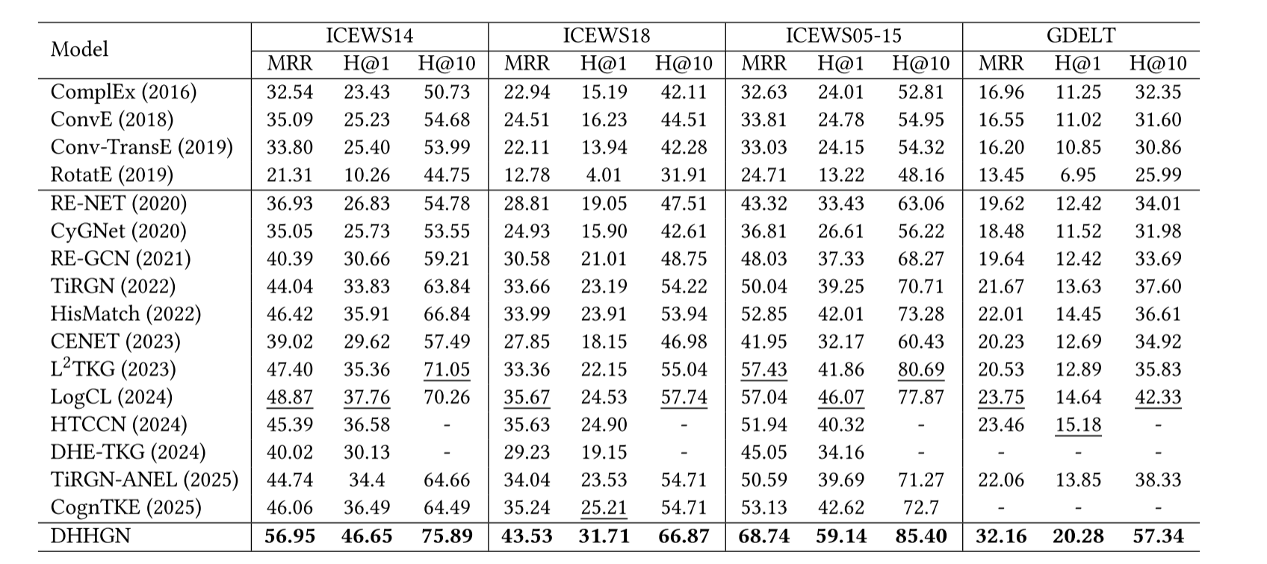
ATAI
Advanced Technique of Artificial Intelligence
ATAI
ChongqingUniversity _{AdvancedTechniqueof}
of Technology Artificial Intelligence
Chongqing University of
Technology
Chongqing University ^{ATAI}
_{of Technology} Advanced Techniqueof
Artificial Intelligence
Chongqing University of Technology
Chongqing University of Technology
Experiments

Slide 8
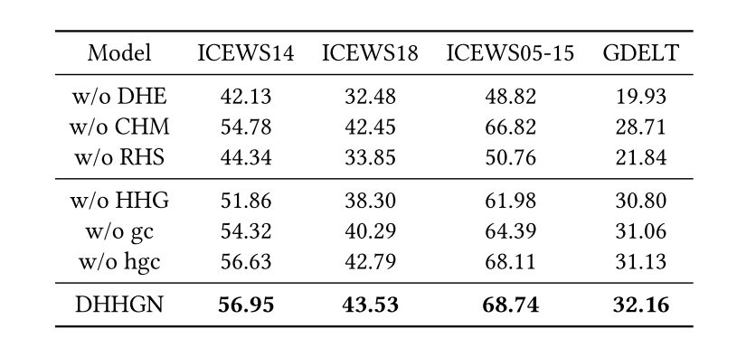
ATAI
Advanced Technique of Artificial Intelligence
ATAI
ChongqingUniversity _{AdvancedTechniqueof}
of Technology Artificial Intelligence
Chongqing University of
Technology
Chongqing University ^{ATAI}
_{of Technology} Advanced Techniqueof
Artificial Intelligence
Chongqing University of Technology
Chongqing University of Technology
Experiments

Slide 9
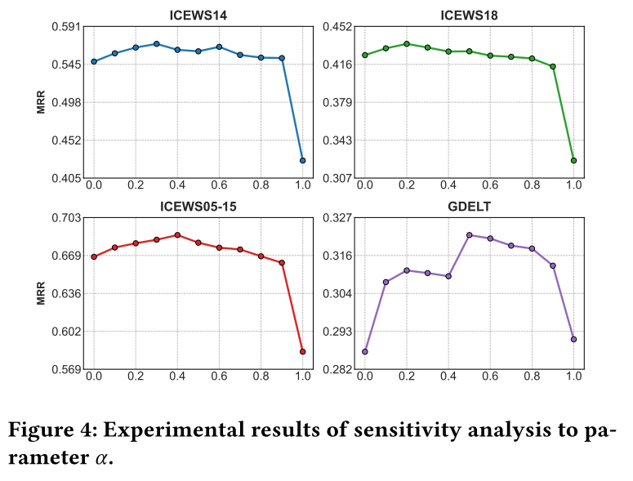
ATAI
Advanced Technique of Artificial Intelligence
ATAI
ChongqingUniversity _{AdvancedTechniqueof}
of Technology Artificial Intelligence
Chongqing University of
Technology
Chongqing University ^{ATAI}
_{of Technology} Advanced Techniqueof
Artificial Intelligence
Chongqing University of Technology
Chongqing University of Technology
Experiments

Slide 10
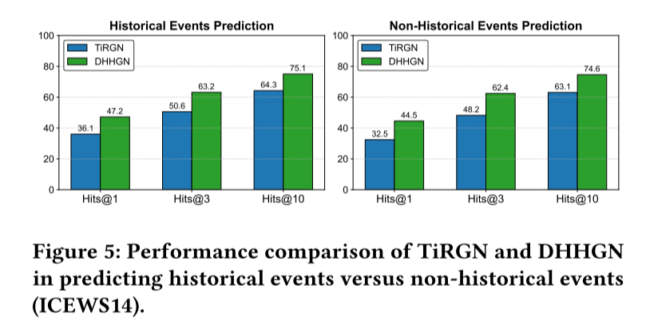
ATAI
Advanced Technique of Artificial Intelligence
ATAI
ChongqingUniversity _{AdvancedTechniqueof}
of Technology Artificial Intelligence
Chongqing University of
Technology
Chongqing University ^{ATAI}
_{of Technology} Advanced Techniqueof
Artificial Intelligence
Chongqing University of Technology
Chongqing University of Technology
Experiments

Slide 11
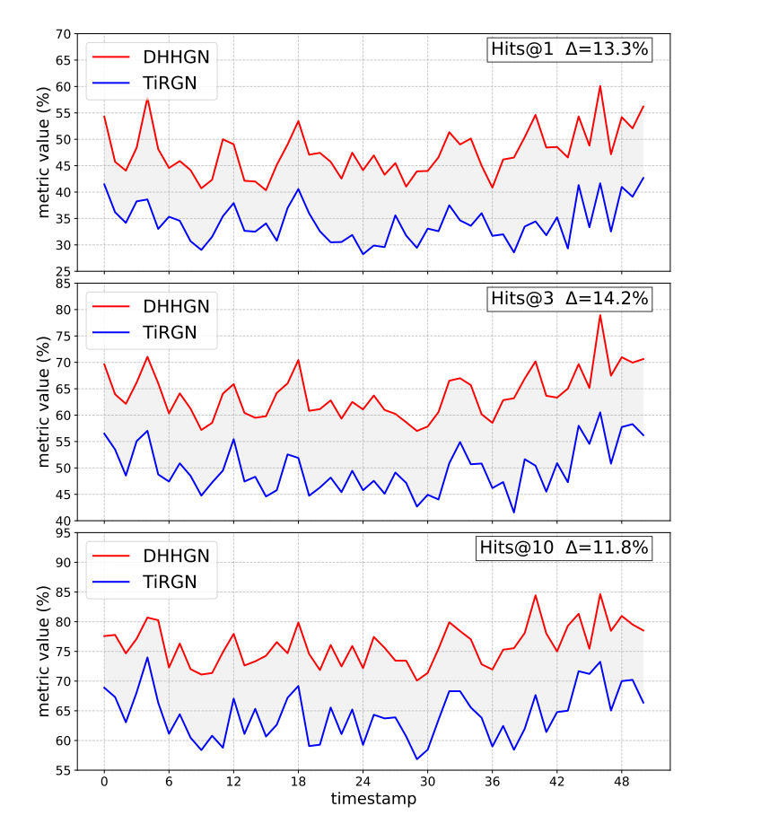
ATAI
Advanced Technique of Artificial Intelligence
ATAI
ChongqingUniversity _{AdvancedTechniqueof}
of Technology Artificial Intelligence
Chongqing University of
Technology
Chongqing University ^{ATAI}
_{of Technology} Advanced Techniqueof
Artificial Intelligence
Chongqing University of Technology
Chongqing University of Technology
Experiments

Slide 12


ATAI
Advanced Technique of Artificial Intelligence
ATAI
ChongqingUniversity _{AdvancedTechniqueof}
of Technology Artificial Intelligence
Chongqing University of
Technology
Chongqing University ^{ATAI}
_{of Technology} Advanced Techniqueof
Artificial Intelligence
Chongqing University of Technology
Chongqing University of Technology
Thanks!

